Slide 1
Storage and File Organization
Notes:
1
The slides for this text are organized into chapters. This lecture covers Chapter 8, which introduces and compares several file and index organizations.
This chapter has been completely rewritten in the 3rd edition of the book., with the goal of being a self-contained discussion of the central concepts of files, B trees, and hash indexes, and how to use them effectively in physical database design. It provides a quantitative comparison of the file storage and indexing alternatives, and how they support efficient evaluation of queries, including the concept of “index-only” evaluation plans.
This chapter can be followed by a more in-depth discussion of B-trees, query evaluation, etc. Alternatively, it gives a concise overview of these topics from the perspective of a potential user, and can be used stand-alone in a course that emphasizes building applications over database system architecture. It covers the essential concepts in sufficient detail to support a discussion of physical database design and tuning in Chapter 20.

Slide 2
Database Design Process
Application 1
Application 2
Application 3
Application 4
External
Model
External
Model
External
Model
External
Model
Application 1
Conceptual
requirements
Application 2
Conceptual
requirements
Conceptual
Model
Logical
Model
Internal Model
Application 3
Conceptual
requirements
Application 4
Conceptual
requirements
Physical Design

Slide 3
Physical Database Design
Many physical database design decisions are implicit in the technology adopted
Also, organizations may have standards or an “information architecture” that specifies operating systems, DBMS, and data access languages -- thus constraining the range of possible physical implementations.
We will be concerned with some of the possible physical implementation issues

Slide 4
Physical Database Design
The primary goal of physical database design is data processing efficiency
We will concentrate on choices often available to optimize performance of database services
Physical Database Design requires information gathered during earlier stages of the design process

Slide 5
Physical Design Information
Information needed for physical file and database design includes:
Normalized relations plus size estimates for them
Definitions of each attribute
Descriptions of where and when data are used
entered, retrieved, deleted, updated, and how often
Expectations and requirements for response time, and data security, backup, recovery, retention and integrity
Descriptions of the technologies used to implement the database

Slide 6
Physical Design Decisions
There are several critical decisions that will affect the integrity and performance of the system
Storage Format
Physical record composition
Data arrangement
Indexes
Query optimization and performance tuning

Slide 7
Storage Format
Choosing the storage format of each field (attribute). The DBMS provides some set of data types that can be used for the physical storage of fields in the database
Data Type (format) is chosen to minimize storage space and maximize data integrity

Slide 8
Storage Issues
Storing & Managing data
very large amounts
Data representation & structures
For efficient data manipulation
Memory hierarchy in DBMS
Cache, Main, Secondary, Tertiary

Slide 9
DB as a simple file system
Think of database as a collection of files
Relation ‘Student’ represented as a file of records
Smith#123#CS
Johnson#522#EEE
Relation schemas stored in a file ‘Schemas’
Students#name#STR#id#INT#dept#STR
Depts#name#STR#office#STR
Inadequate for applications involving significant amounts of data and multiple users

Slide 10
Disadvantages
Tuple layout on disk is inadequate, with no flexibility for DB modifications
Queries are inefficient
All data comes off the disk, all the time
No concurrency control as several users can modify a file at the same time
No reliability in view of system crash

Slide 11
Disks and Files
DBMS stores information on (“hard”) disks.
This has major implications for DBMS design!
– READ: transfer data from disk to main memory (RAM).
– WRITE: transfer data from RAM to disk.
– Both are high-cost operations, relative to in-memory operations. Plan your actions carefully so as to minimize the number of of READ and WRITE operations.

Slide 12
Memory Hierarchy
Cache
Very fast access, but limited capacity
Main memory
Random access
Virtual memory address space
Through OS’s Page replacement mechanism
32-bit machine will have address space of 2³² (4GB)
Main-Memory Database Systems
Large-scale DB systems manage their data directly on the disk

Slide 13
Main Memory
Fastest, most expensive (excluding cache)
Today: 16GB are common even on PCs
Many databases could fit in memory
New industry trend: Main Memory Database
E.g TimesTen
Main issue is volatility

Slide 14
Secondary storage
Also random-access
Files are moved between MM and disk in blocks (known as disk I/O) through MM buffers
Disk I/O time is very significant and effects the performance of the system
Capacity: 500GB and above

Slide 15
Secondary Storage
Disks
Slower, cheaper than main memory
Persistent !!!
The unit of disk I/O = block
Typically 1 block = 4k
A disk block is also called a disk page or simply a page
Used with a main memory buffer

Slide 16
Tertiary storage
Business data bases, Scientific data
Non uniform data access times
Example storage systems
Disk Juke Boxes: racks of CD-ROM’s
Tape Silos: Racks of Tapes

Slide 17
The Memory Hierarchy
Main Memory = Disk Cache
Processor Cache:
access time 10 nano’s
512K
Volatile
256M-1G
Access time:
10-100 nanoseconds
Disk
Tape
Persistent
100-1000 GB storage
speed:
Rate=5-10 MB/S
Access time=
10-15 msecs.
1.5 MB/S transfer rate
280 GB typical
capacity
Only sequential access
Not for operational
data

Slide 18
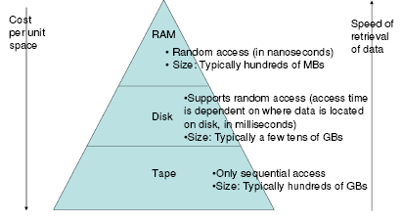
Memory Hierarchy

Slide 19
Why not store Everything in main memory?
Costs too much: Cost of RAM about 100 times the cost of the same amount of disk space.
Main memory is volatile. We want data to be saved between runs.
Typical storage hierarchy:
– Main memory (RAM) for currently used data.
– Disk for the main database (secondary storage).
– Tapes for archiving older versions of the data (tertiary
storage)

Slide 20
Let R has 10,000,000 tuples with 100 records/block where block size is 16KB (2¹⁴)
R occupies 100,000 blocks
Assume the system has 100MB of main memory buffers
The no.of blocks that can fit in memory is 6400

Slide 21
Storage Access
A database file is partitioned into fixed-length storage units called blocks. Blocks are units of both storage allocation and data transfer.
Database system seeks to minimize the number of block transfers between the disk and memory. We can reduce the number of disk accesses by keeping as many blocks as possible in main memory.
Buffer – portion of main memory available to store copies of disk blocks.
Buffer manager – subsystem responsible for allocating buffer space in main memory.

Slide 22
Optimization of Disk-Block Access
Block – a contiguous sequence of sectors from a single track
data is transferred between disk and main memory in blocks
sizes range from 512 bytes to several kilobytes
Smaller blocks: more transfers from disk
Larger blocks: more space wasted due to partially filled blocks
Typical block sizes today range from 4 to 16 kilobytes

Slide 23
Optimization of Disk Block Access
File organization – optimize block access time by organizing the blocks to correspond to how data will be accessed
E.g. Store related information on the same or nearby cylinders.
Files may get fragmented over time
E.g. if data is inserted to/deleted from the file
Or free blocks on disk are scattered, and newly created file has its blocks scattered over the disk
Sequential access to a fragmented file results in increased disk arm movement
Some systems have utilities to defragment the file system, in order to speed up file access

Slide 24
Optimization of Disk Block Access
Nonvolatile write buffers speed up disk writes by writing blocks to a non-volatile RAM buffer immediately
Non-volatile RAM: battery backed up RAM or flash memory
Even if power fails, the data is safe and will be written to disk when power returns
Controller then writes to disk whenever the disk has no other requests or request has been pending for some time
Database operations that require data to be safely stored before continuing can continue without waiting for data to be written to disk
Writes can be reordered to minimize disk arm movement
Log disk – a disk devoted to writing a sequential log of block updates
Used exactly like nonvolatile RAM
Write to log disk is very fast since no seeks are required
No need for special hardware (NV-RAM)
File systems typically reorder writes to disk to improve performance
Journaling file systems write data in safe order to NV-RAM or log disk
Reordering without journaling: risk of corruption of file system data

Slide 25

Attendance (12.03.2020)

Slide 26
Data representation

Slide 27
Issues
How do we represent
Datatypes as fields
Fixed/variable tuples
Records into blocks
Relation as collection of blocks (file)
How do we handle Database modifications when record size changes

Slide 28
File Organization
The database is stored as a collection of files. Each file is a sequence of records. A record is a sequence of fields.
One approach:
assume record size is fixed
each file has records of one particular type only
different files are used for different relations

Slide 29
Representing DataTypes
Fixed length Character String: CHAR(n)
Using special ‘Pad’ Character
Variable length Character String: VARCHAR(n)
Using n+1 bytes
Two representations:
Length plus content
Null-terminated string
Dates and Times: DATE (10 byte representation)
Can be represented as fixed/variable character string
A sequence of Bits: BIT(n)
Enumerated Type : finite set of values

Slide 30
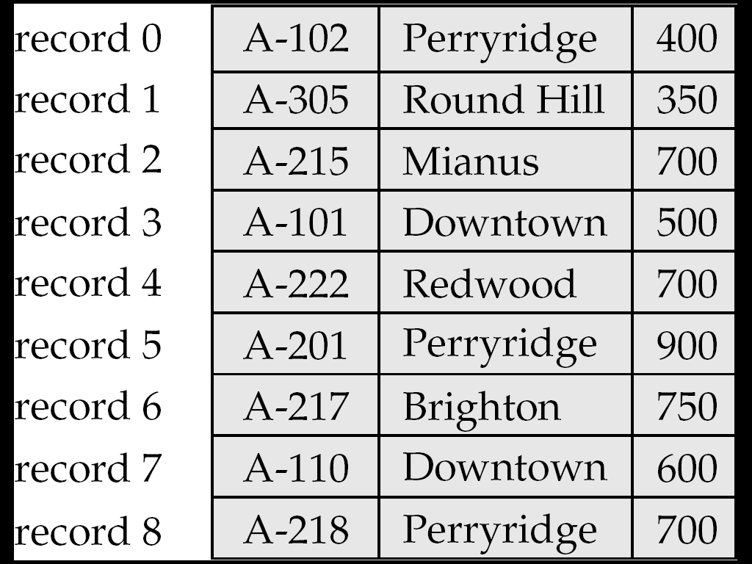
Fixed-Length Records
Simple approach:
Store record i starting from byte n ∗ (i – 1), where n is the size of each record.
Record access is simple but records may cross blocks
Modification: do not allow records to cross block boundaries
Deletion of record i: alternatives:
move records i + 1, . . ., n to i, . . . , n – 1
move record n to i
do not move records, but link all free records on a free list

Slide 31
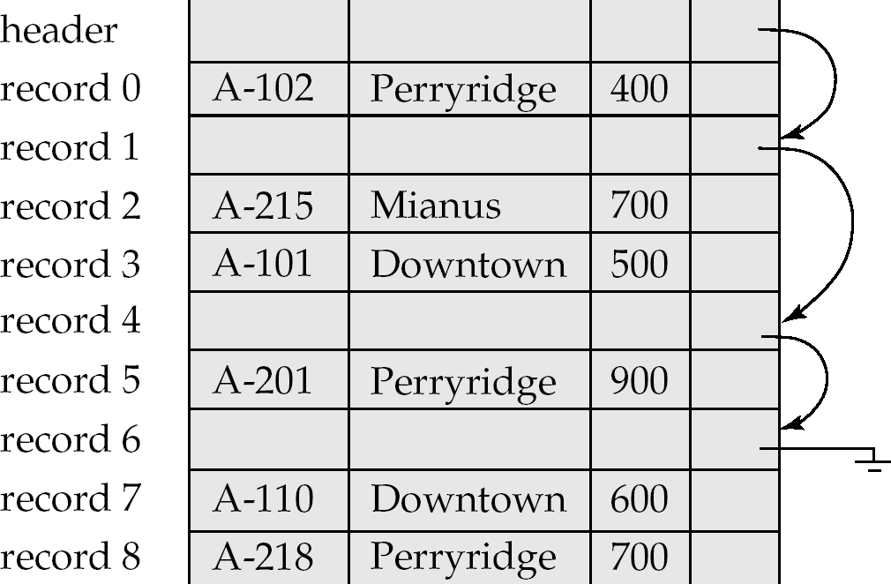
Free Lists
Store the address of the first deleted record in the file header.
Use this first record to store the address of the second deleted record, and so on
Can think of these stored addresses as pointers since they “point” to the location of a record.
More space efficient representation: reuse space for normal attributes of free records to store pointers. (No pointers stored in in-use records.)

Slide 32
Variable-Length Records
Variable-length records arise in database systems in several ways:
Storage of multiple record types in a file.
Record types that allow variable lengths for one or more fields.
Record types that allow repeating fields (used in some older data models).

Slide 33
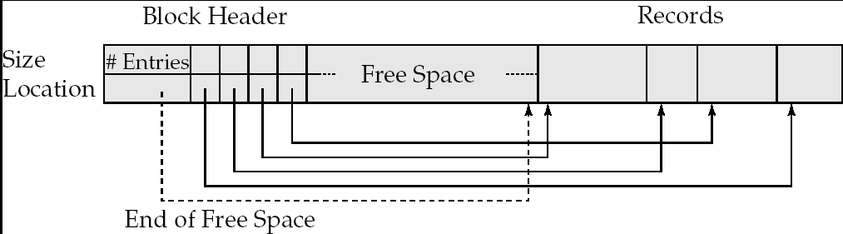
Variable-Length Records: Slotted Page Structure
Slotted page header contains:
number of record entries
end of free space in the block
location and size of each record
Records can be moved around within a page to keep them contiguous with no empty space between them; entry in the header must be updated.
Pointers should not point directly to record — instead they should point to the entry for the record in header.

Slide 34
Representing Fixed-length Records
Simplest situation
Record Header
Pointer to record schema
Length of the record
Timestamps
length
0
12
44
300
304
316
name
address
birthdate
schema
timestamp
gender

Slide 35
Representing Blocks with fixed-length records
Optional block header
A block ‘ID’
Links to other blocks of the logical network
Information about relation(s) of the tuples
Directory of record offsets
Timestamp(s)
header
record1
record2
record n

Slide 36
Block representation
We need enough information about records to locate them in a block
The simplest case is when the records are of fixed-length
Using ‘offset’ table
Efficient for variable-length records
Unused
Record 3
Record 2
Record 1

Slide 37
Data on External Storage
Disks: Can retrieve random page at fixed cost
But reading several consecutive pages is much cheaper than reading them in random order
Tapes: Can only read pages in sequence
Cheaper than disks; used for archival storage
File organization: Method of arranging a file of records on external storage.
Record id (rid) is sufficient to physically locate record
Indexes are data structures that allow us to find the record ids of records with given values in index search key fields
Architecture: Buffer manager stages pages from external storage to main memory buffer pool. File and index layers make calls to the buffer manager.

Slide 38
Alternative File Organizations
Many alternatives exist, each ideal for some situations, and not so good in others:
Heap (random order) files: Suitable when typical access is a file scan retrieving all records.
Sorted Files: Best if records must be retrieved in some order, or only a `range’ of records is needed.
Indexes: Data structures to organize records via trees or hashing.
Like sorted files, they speed up searches for a subset of records, based on values in certain (“search key”) fields
Updates are much faster than in sorted files.
Notes:
2

Slide 39
Internal Schema Design

